Slide 1
Federal Highway Administration
PoDI Selection Process
Duane Thomas
September 6, 2016

Slide 2
PoDI
Projects of Division Interest
PoDI

Slide 3

Stewardship and Oversight
Project Stewardship and Oversight
Project Approval Actions
PoDI
PoCI
CAP

Slide 4
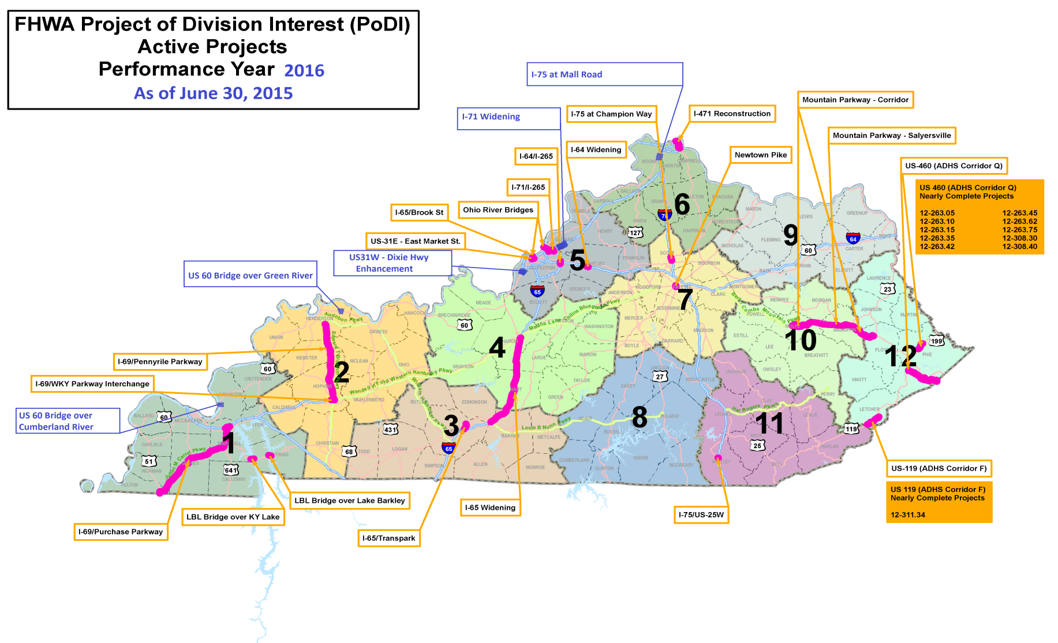
PoDI Projects 2016

Slide 5
PoDI Selection Process
Timing:
6-Year Plan Cycle
Major Updates in Budget Year
Minor Updates in off-year

Slide 6
PoDI Selection Process
PoDI Project Selection:
Mandatory
  Major Projects
  EIS
  TIGER
Risk Based

Slide 7
PoDI Selection Process
Risk Assessment:
FHWA Risks vs Project Risks
Project Phase (NEPA, Design, Construction)
Project Activity (FY 2017 and 2018)

Slide 8
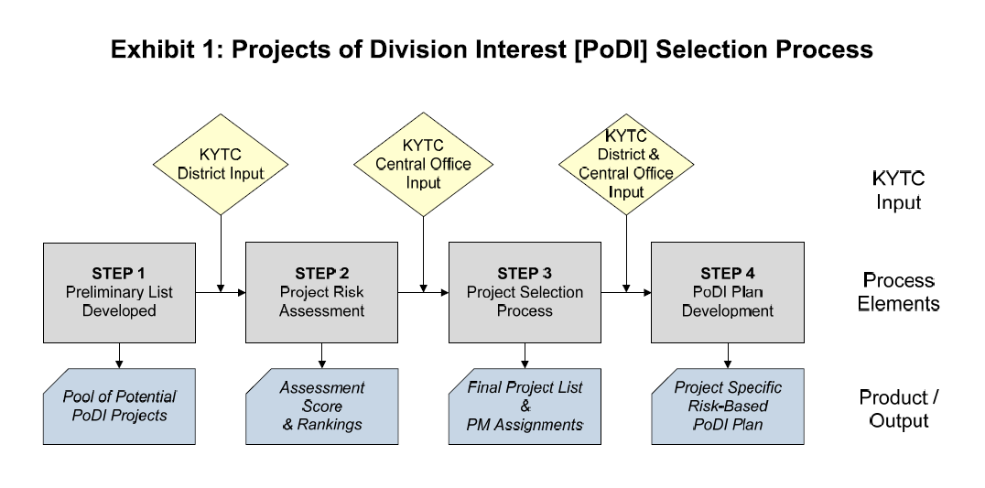
PoDI Selection Process

Slide 9
PoDI Selection Process
Selection Process Changes:
KYTC Input
Transparency / Accessibility
Geographic Representation
Implementation Plans more aligned with specific project risks

Slide 10
PoDI Selection Process
Next Steps:
Division Project Selection
KYTC Input
Final List
Implementation Plans

